Slide 1
Alpha+ Calculations Engine
Technology compliance

Slide 2
Summary of position
Alpha+ is written in C++ using Microsoft Visual C++ 2003, as unmanaged code in the .net environment.
The ACE team have now taken delivery of Microsoft Visual C++ 2005 and will be migrating development to this environment.
The following slide (taken from http://download.microsoft.com/download/e/1/e/e1e86586-a01e-41e9-91a9-6a12ded994e4/2006-01-05_MSDN_Evening_Lap_Around_Visual_CPlusPlus.ppt) gives support information for both of these versions of Microsoft Visual C++.
The final slide is a component diagram of the Alpha+ architecture.

Slide 3
Visual C++ Past & Present
 | Visual C++ 6 | Visual C++ 2002 | Visual C++ 2003 | Visual C++ 2005
Release Date | 1998 | 2002 | 2003 | 2005
Target Platforms | Windows 95 to Windows NT 4.0 | Windows 98 to Windows XP | Windows 2000 to Windows Server 2003 | Windows 2000 to Windows Server 2003
Libraries and Technologies | Win32, COM, MFC, ATL | Win32, COM, MFC, ATL, .NET, Web Services | Win32, COM, MFC, ATL, .NET, Web Services | Win32, COM, MFC, ATL, .NET, Web Services
Distinguishing Features | Introduced IntelliSense | Introduced support for .NET | Improved ISO C++ conformance | Improved support for .NET and Windows platforms
Support | Extended support expired September 30, 2005 | Extended support expires June 30, 2009 | Extended support expires September 30, 2013 | Just shipped!

Slide 4
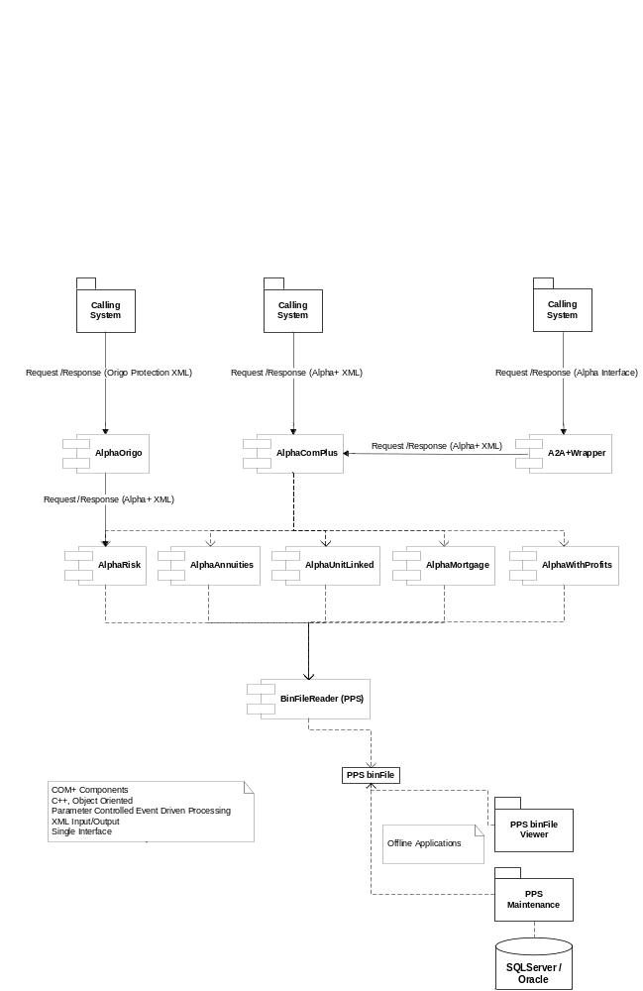
Alpha+ component diagram

